Slide 1

I2ROS Group13
Autonomous Driving
Chenyu Meng
Zefeng Wang
Qiyang Zong
Yulong Xiao
Yichao Gao
Technische Universität München
02.08.2023
Notes:
Hi, Professor Ryll, my name is Chenyu Meng from group 13. My teammates and I are working together on the topic Autonomous Driving.

Slide 2
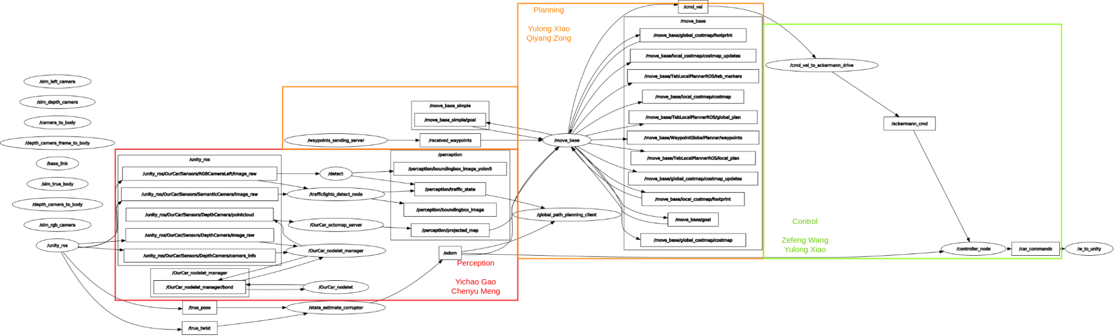
Task Distribution
Module | Contributors
Preception | Chenyu Meng, Yichao Gao
Planning | Qiyang Zong, Yulong Xiao
Control & State machine | Zefeng Wang
Notes:
The tasks are distributed showed in the table,

Slide 3
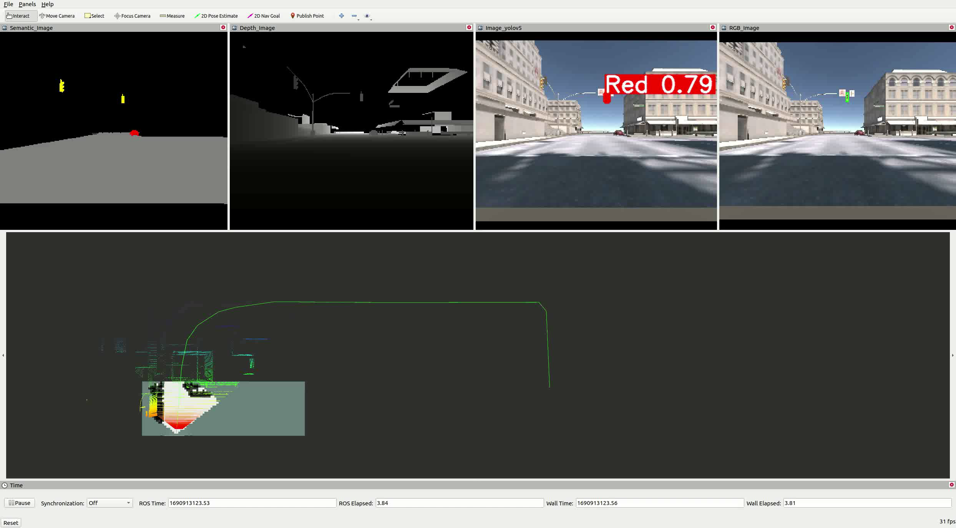
Route 1
Finish time: 212 seconds
Notes:
We accomplished the task with two different methods. The difference between the 2 methods will be explained later. In this slide, the performance of route 1 is showed in the video, the total runtime is 212 seconds.

Slide 4
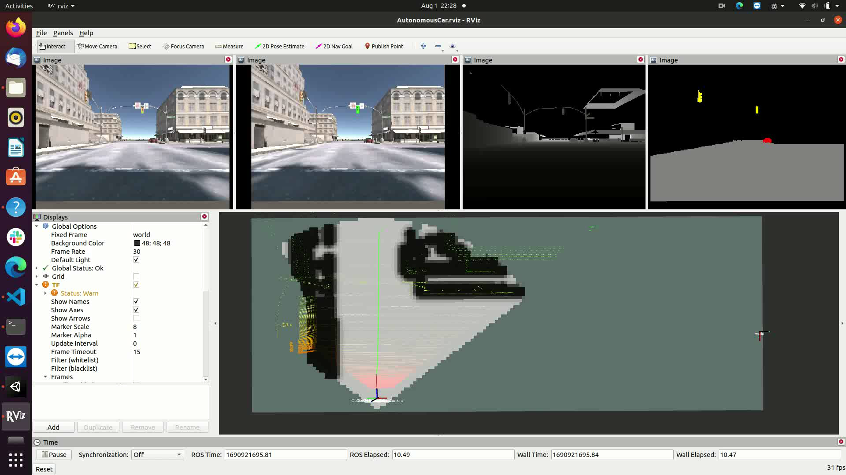
Route 2
Finish time: 600 seconds
Notes:
This video presents the performance of route 2, which is much slower than route 1.

Slide 5
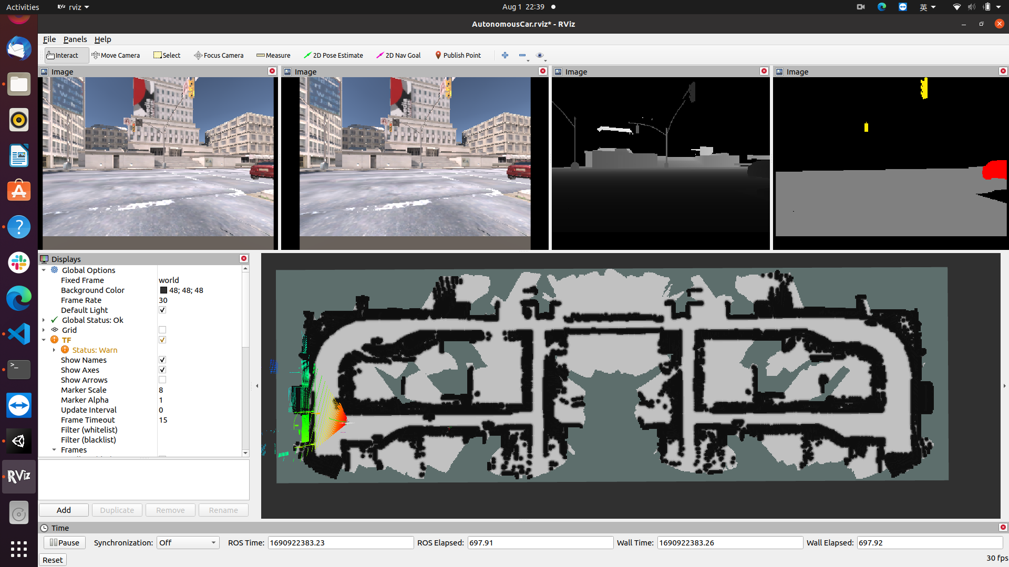
Route 2
Finish time: 600 seconds
Notes:
The route 2 is not stable. The result highly depends on the available computational resources. It takes 10 minutes to reach the goal point.

Slide 6
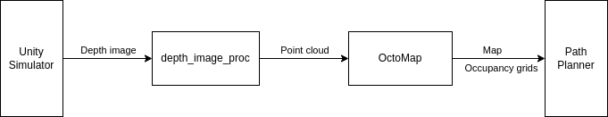
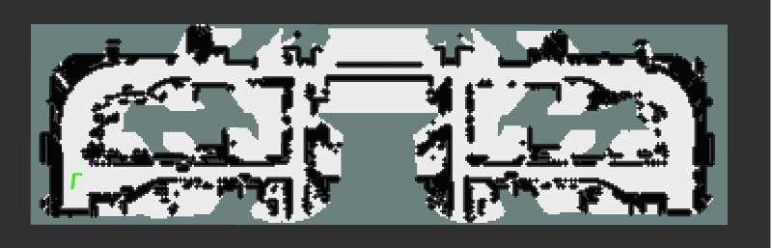
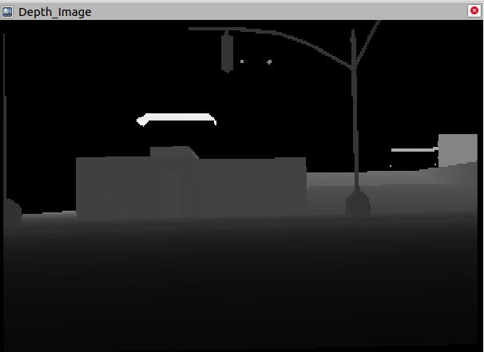
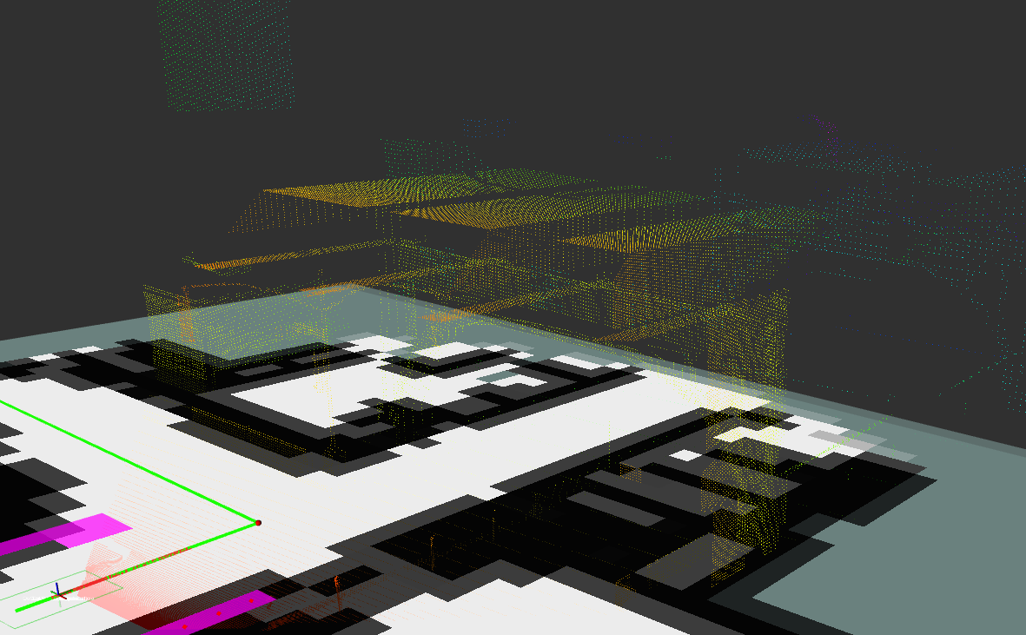
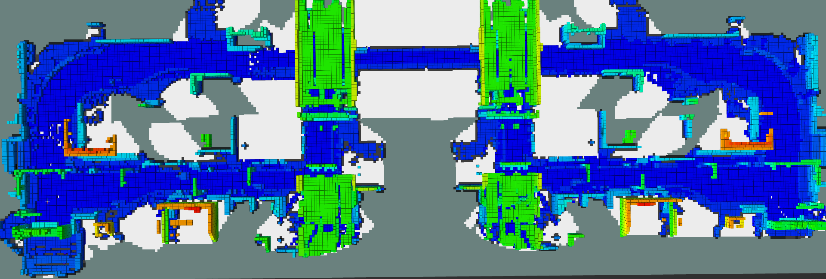
Perception pipeline
Notes:
In perception piple, point cloud is generated using the depth image provided by Unity Simulator, And the point cloud is the input of the OctoMap package to build a map for Path Planner.

Slide 7
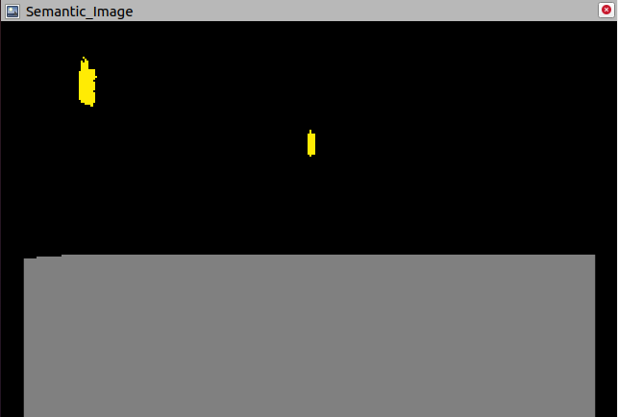
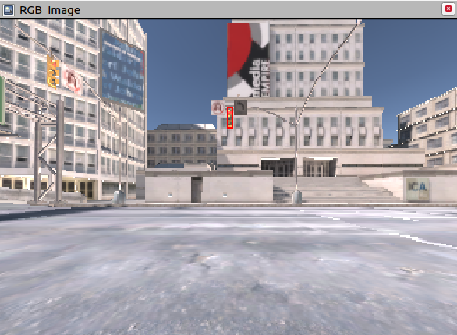
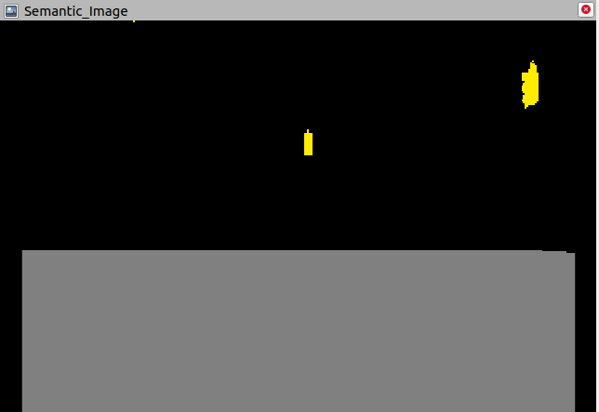
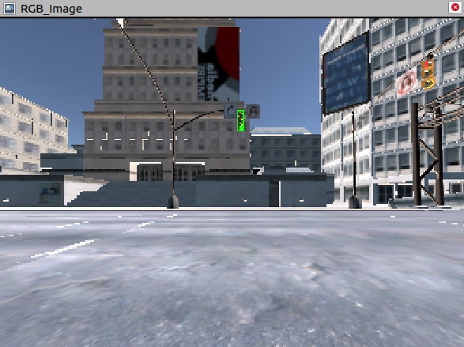
Perception: traffic lights detection
Solution1: traditional CV-based detection
Red light:
Green light:
Semantic image
RGB image
Notes:
We extract the position of the trafflic light from semantic image and achieve color detection with the help of RGB image.

Slide 8
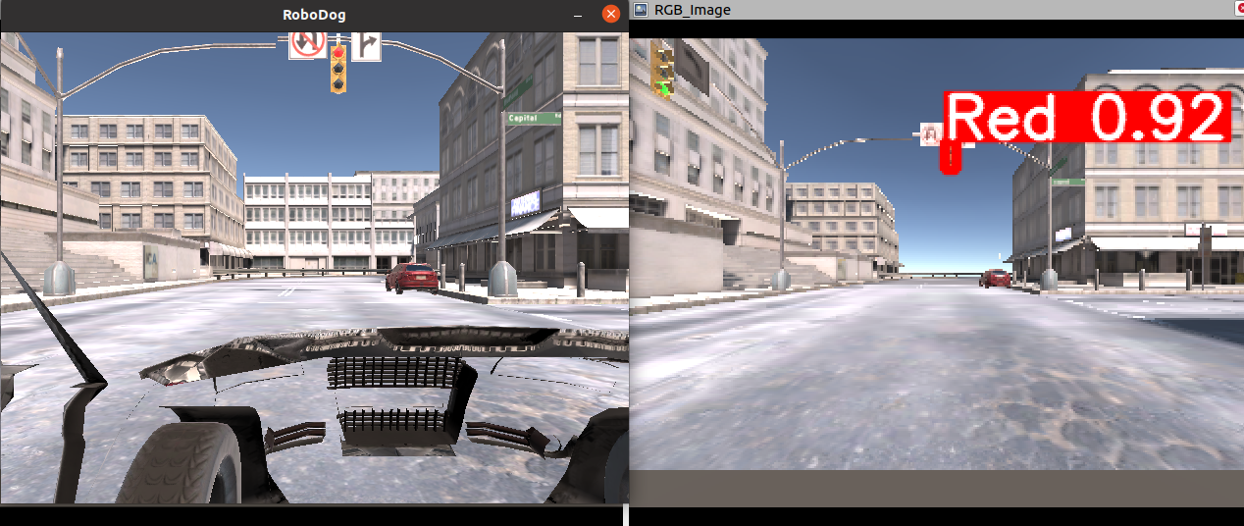
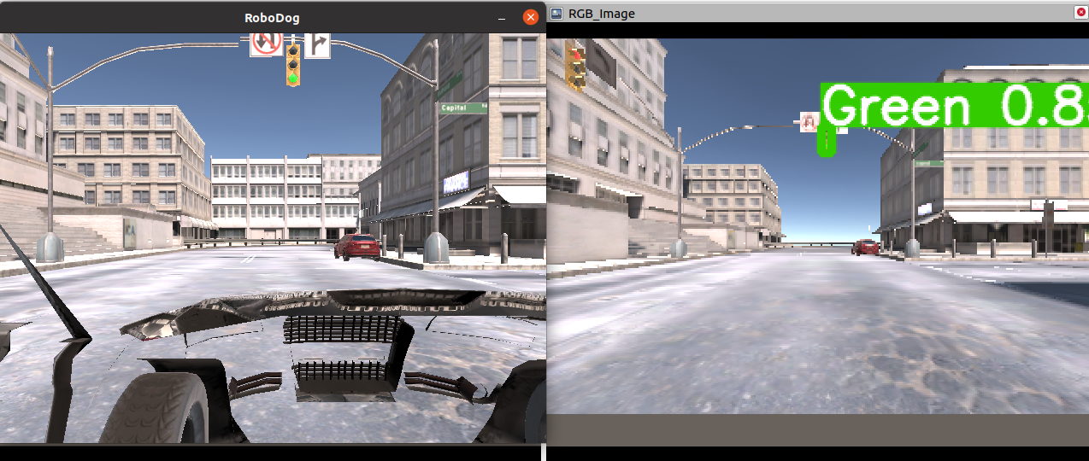
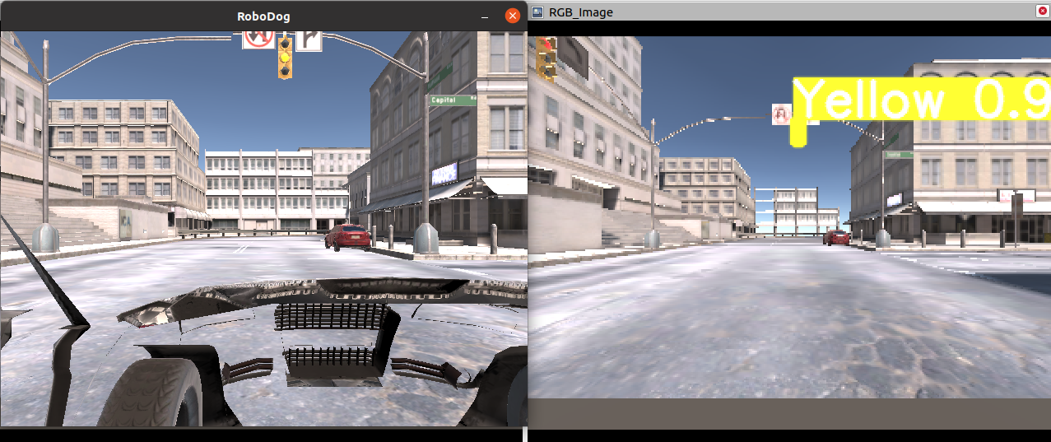
Perception: traffic lights detection
Solution2: Deep-learning-based detection
Red light:
Green light:
Yellow light:
RGB image
Annotated RGB image
Notes:
We use YOLOv5 as our model and it can successfully detect all the traffic lights with higher confidence.

Slide 9
Planning: move_base
/realsense/depth/pointcloud
input of move_base:
sensor transforms
odom source
sensor source
goal
local
costmap
global
costmap
/tf
out of move_base:
/odom
local planner
global
planner
the desired linear speed
the desired angular speed
/cmd_vel
/goal
Notes:
The move base package is applied for planning. Here is a structure of move base.

Slide 10
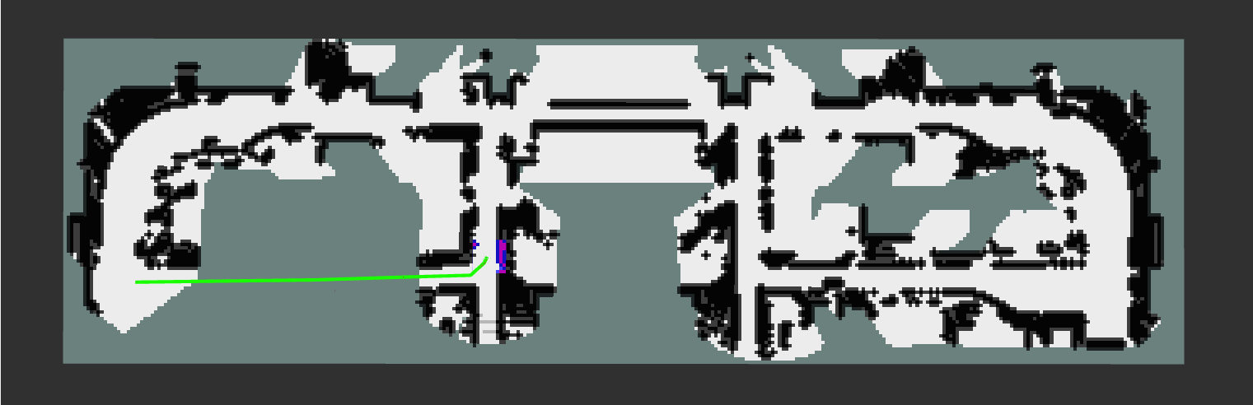
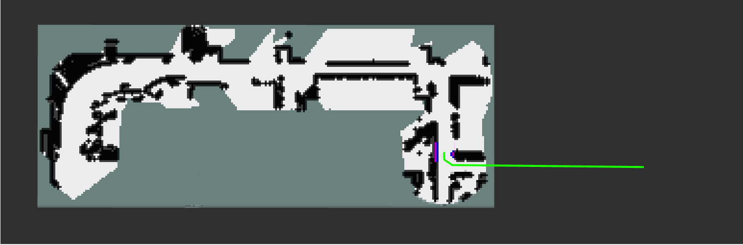
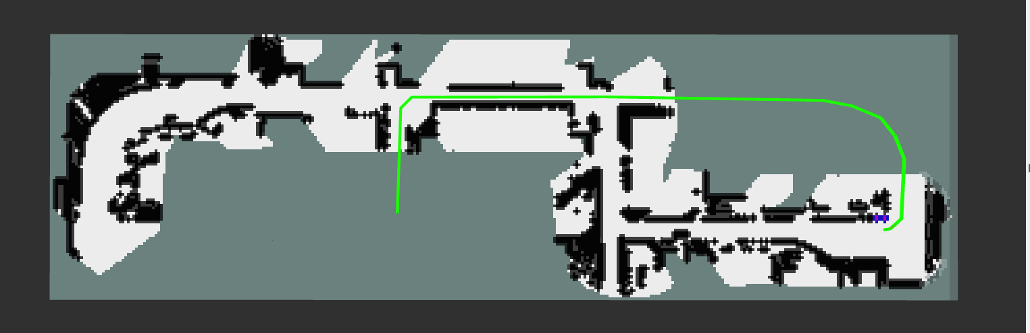
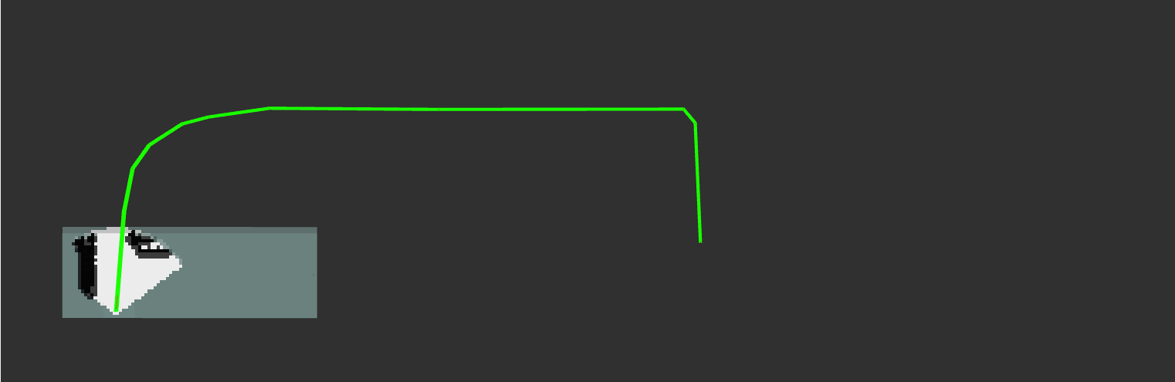
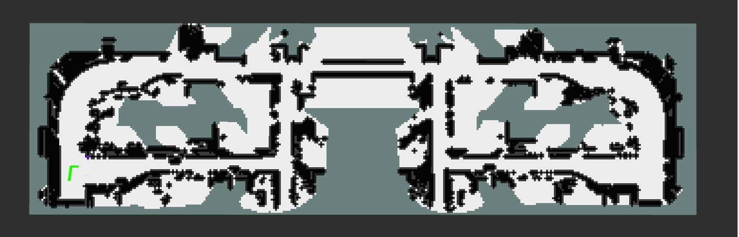
Planning: Waypoint Global Planning
path planning by drawing straight lines between two predefined waypoints
server-client pair to publish paths and obey traffic lights
used in Route 1
Notes:
Now we will introduce the difference between 2 routes. The first difference is the global planner, in route 1 we use waypoint global planning, it achieves path planning by drawing straight lines between several predefined waypoints, is it more suitable for deterministic environment (free of dynamic obstacles) and predefined path.

Slide 11
Planning: Waypoint Global Planning
global path planning client:
/odom
/perception/traffic_state
paths are separated by traffic lights
publish next path only when the car is close enough to the traffic light and the traffic light is green
/global_path_planning_client
call
/waypoints_sending_server
/recieved_waypoints
/move_base
Notes:
Traffic light obeying is integrated to global_path_planning_client.

Slide 12
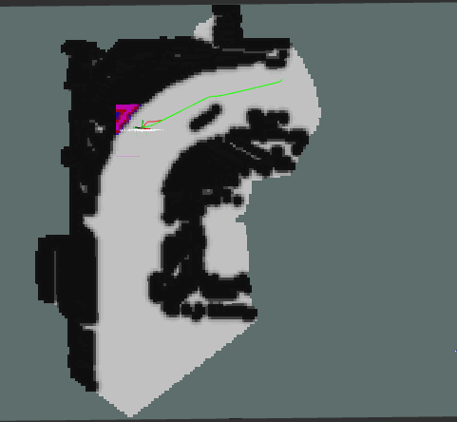
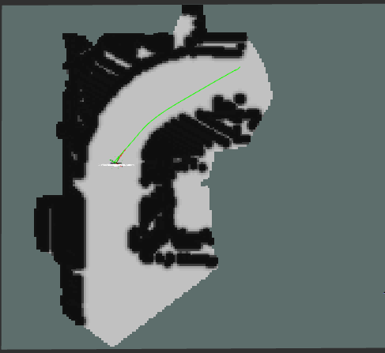
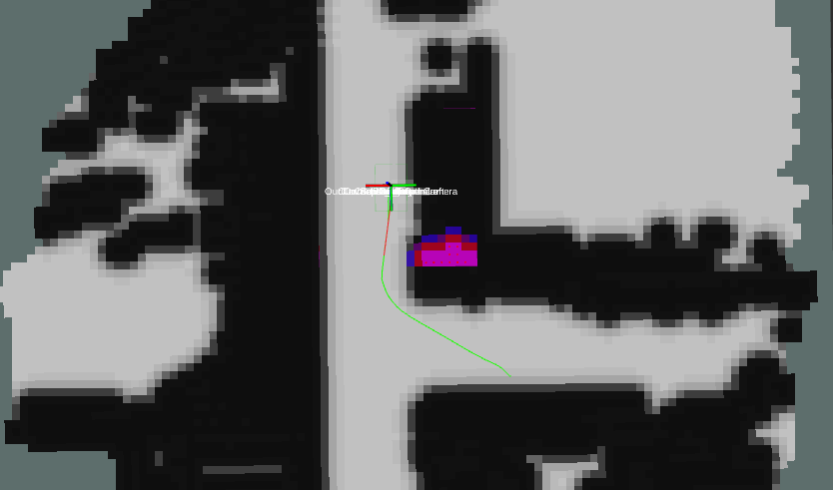
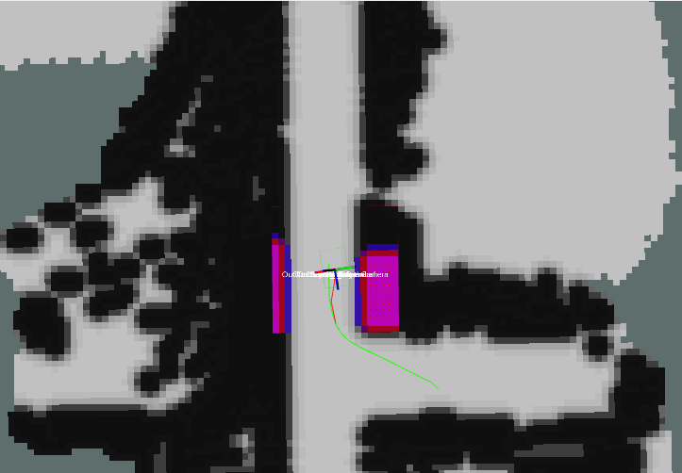
Planning: Goal-Point Global Planning
move_base build-in global planner, path can be updated over time
tuning parameters e.g. observation_persistance
used in Route 2
Notes:
the default global_planner uses searching algorithm like A* to explore a feasible path to the goal, but is more suitable for dynamic environment, more vulnerable to errors.

Slide 13
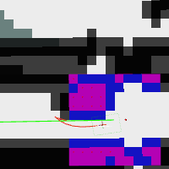
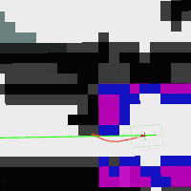
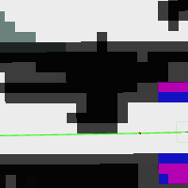
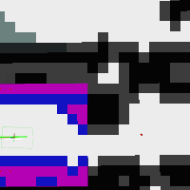
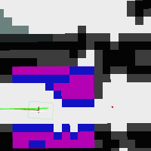
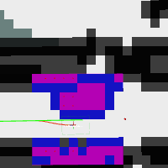
Planning: Local planning
determine velocities to send to the robot, avoid obstacles
local planner:
teb_local_planner, provide better support for car-like robot (Route 1)
base_local_planner (Route 2)
3
2
1
16
5
4
Notes:
(Here shows the difference between 2 routes.)
Red line is local trajectory, green is global path, we show obstacle avoidance here.
only difference of the 2 local planner is that teb_local_planner is more suitable for car-like robot, providing possibility to set minimum turning radius to avoid in-place rotation

Slide 14
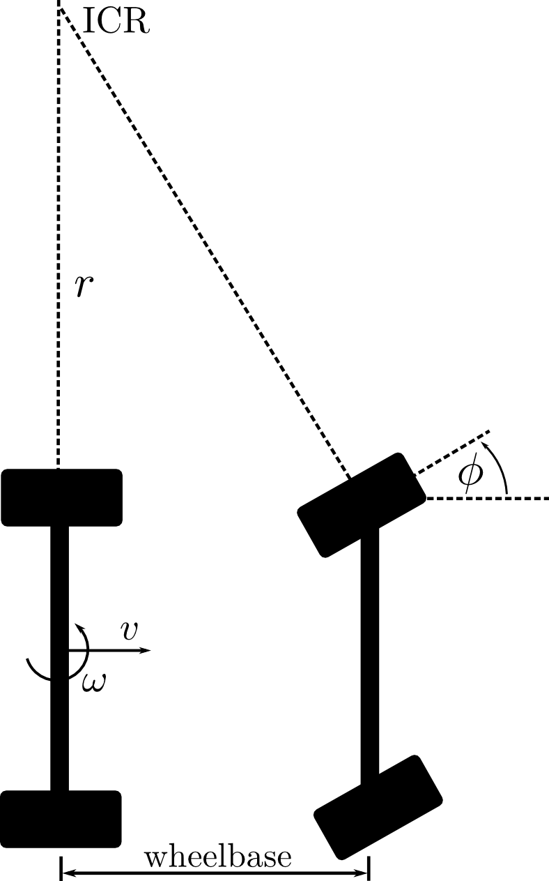
Control: Ackermann controller
calculation steering angle out of desired linear and angular velocity
calculation acceleration using P(proportional) controller
used in route 1
/move_base
/cmd_vel
/cmd_vel_to_ackermann_msg_node
/ackermann_cmd
/odom
/controller_node
/car_commands
Notes:
Main purpose of the conversion to ackermann_msg is to obtain the steering angle as a direct command to our car.

Slide 15
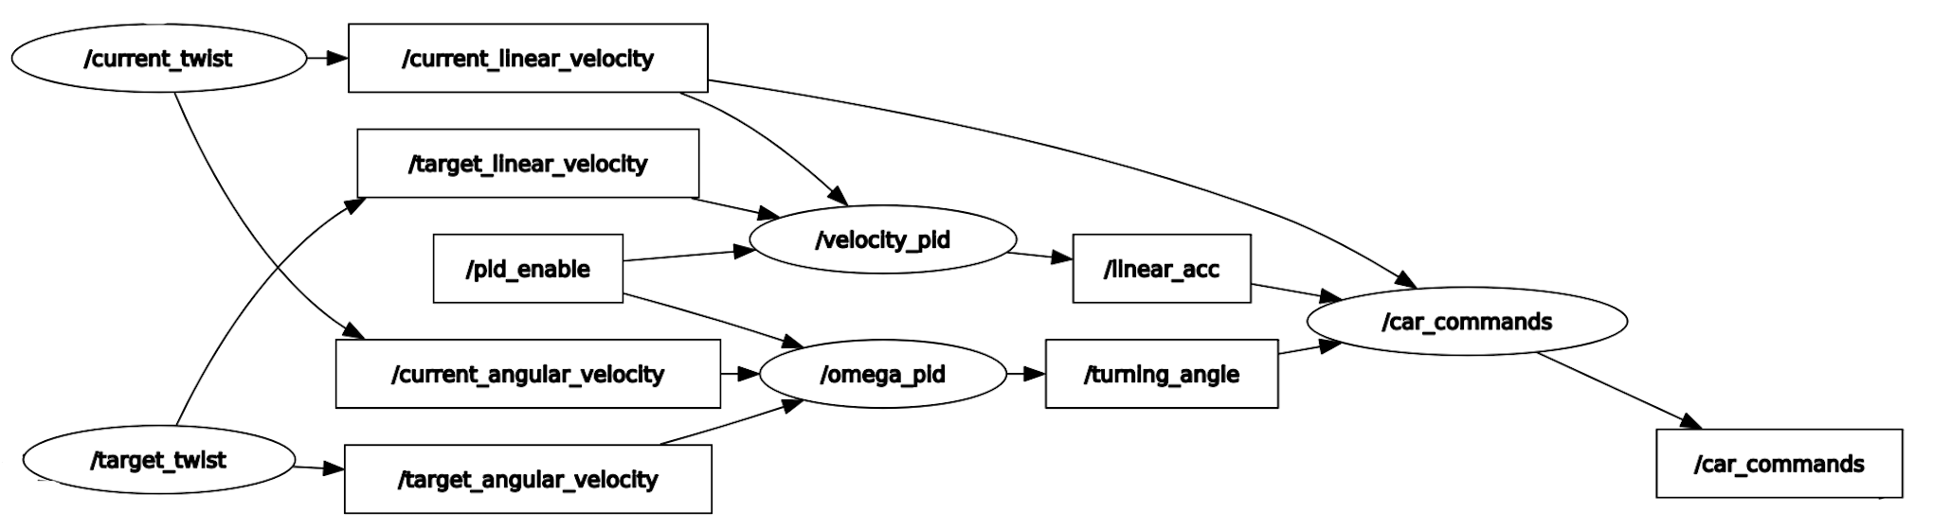
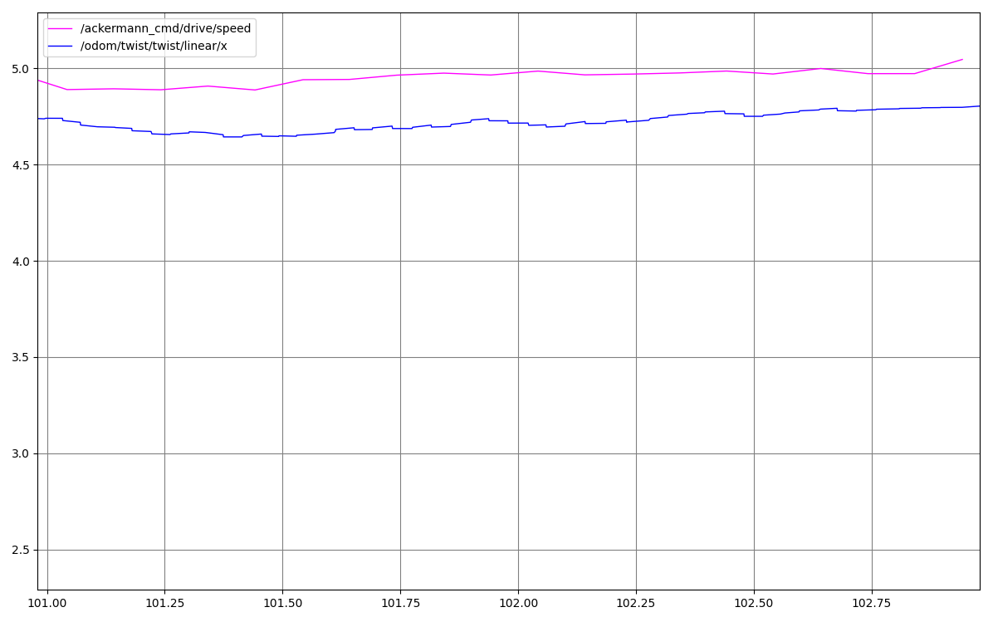
PID controller
Used in Route 2
2 PID control turning angle and linear velocity separately
Notes:
The dynamic model is unknown, so with a simple straightforward control, there will be a steady error, which may caused by the resistance.

Slide 16
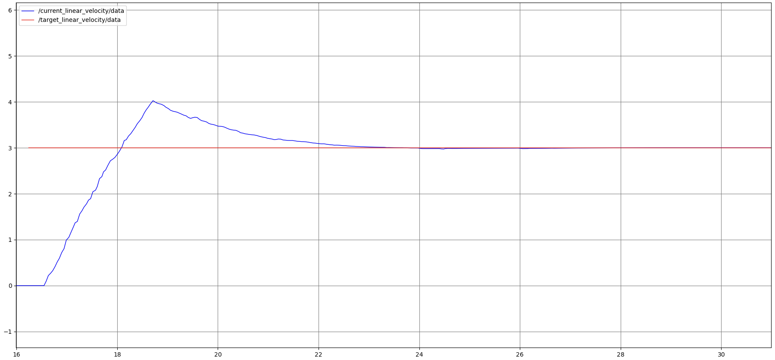
PID controller
Used in Route 2
2 PID control turning angle and linear velocity separately
Notes:
With PID control, the dynamic model of the car is not necessary. We can achieve a precise control.

Slide 17
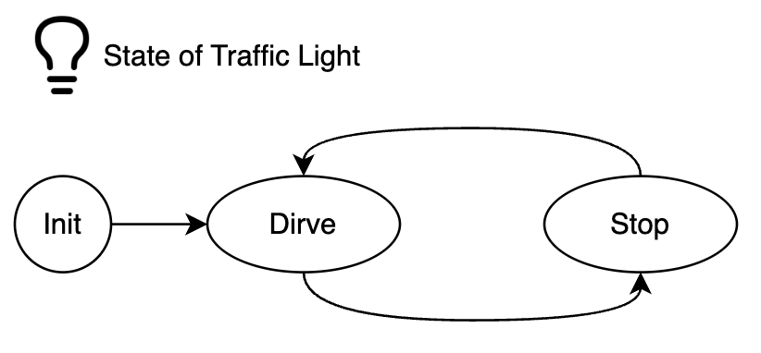
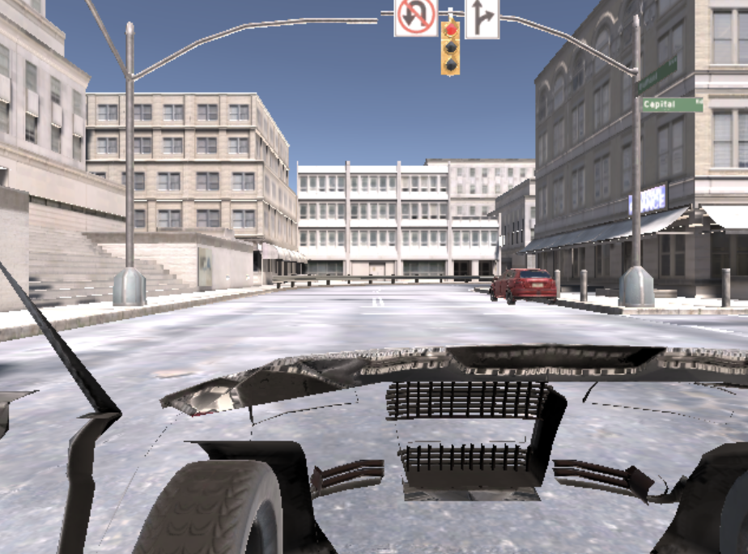
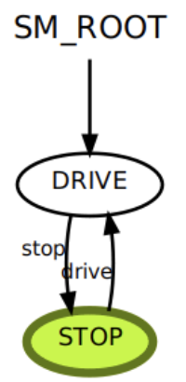
State Machine
Used in Route 2
Notes:
State machine is used to publish the setpoints to the two PID controllers. And the state switches with the traffic light state which is a global flag and filtered with a low-pass filter against the jitter.

Slide 18
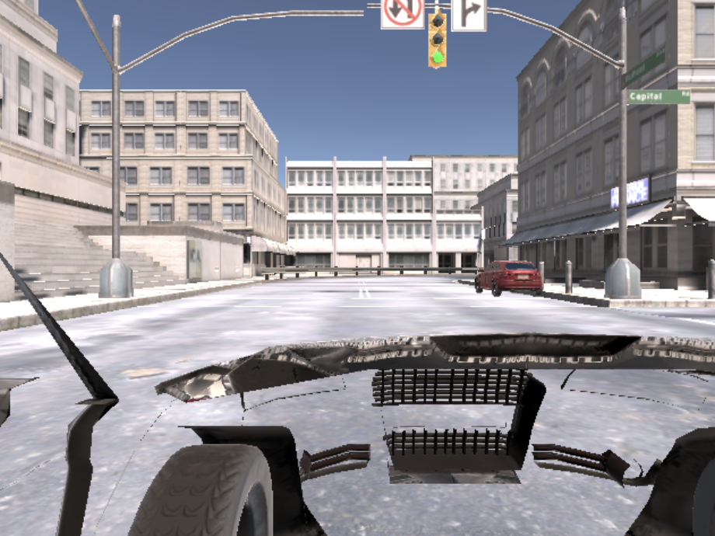
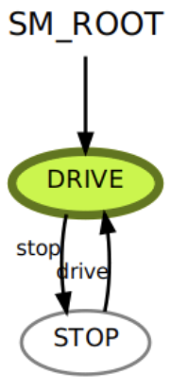
State Machine
Used in Route 2

Slide 19
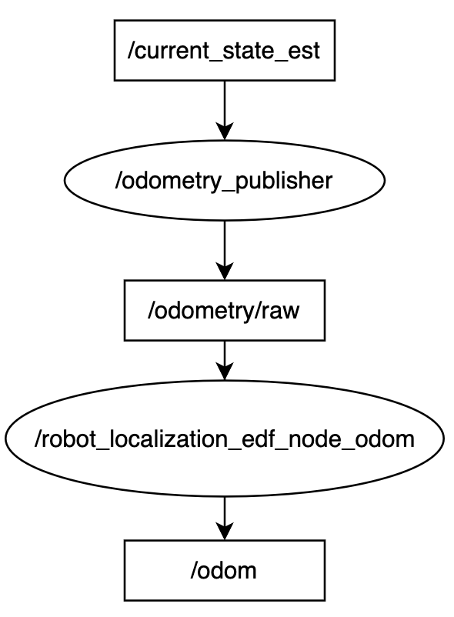
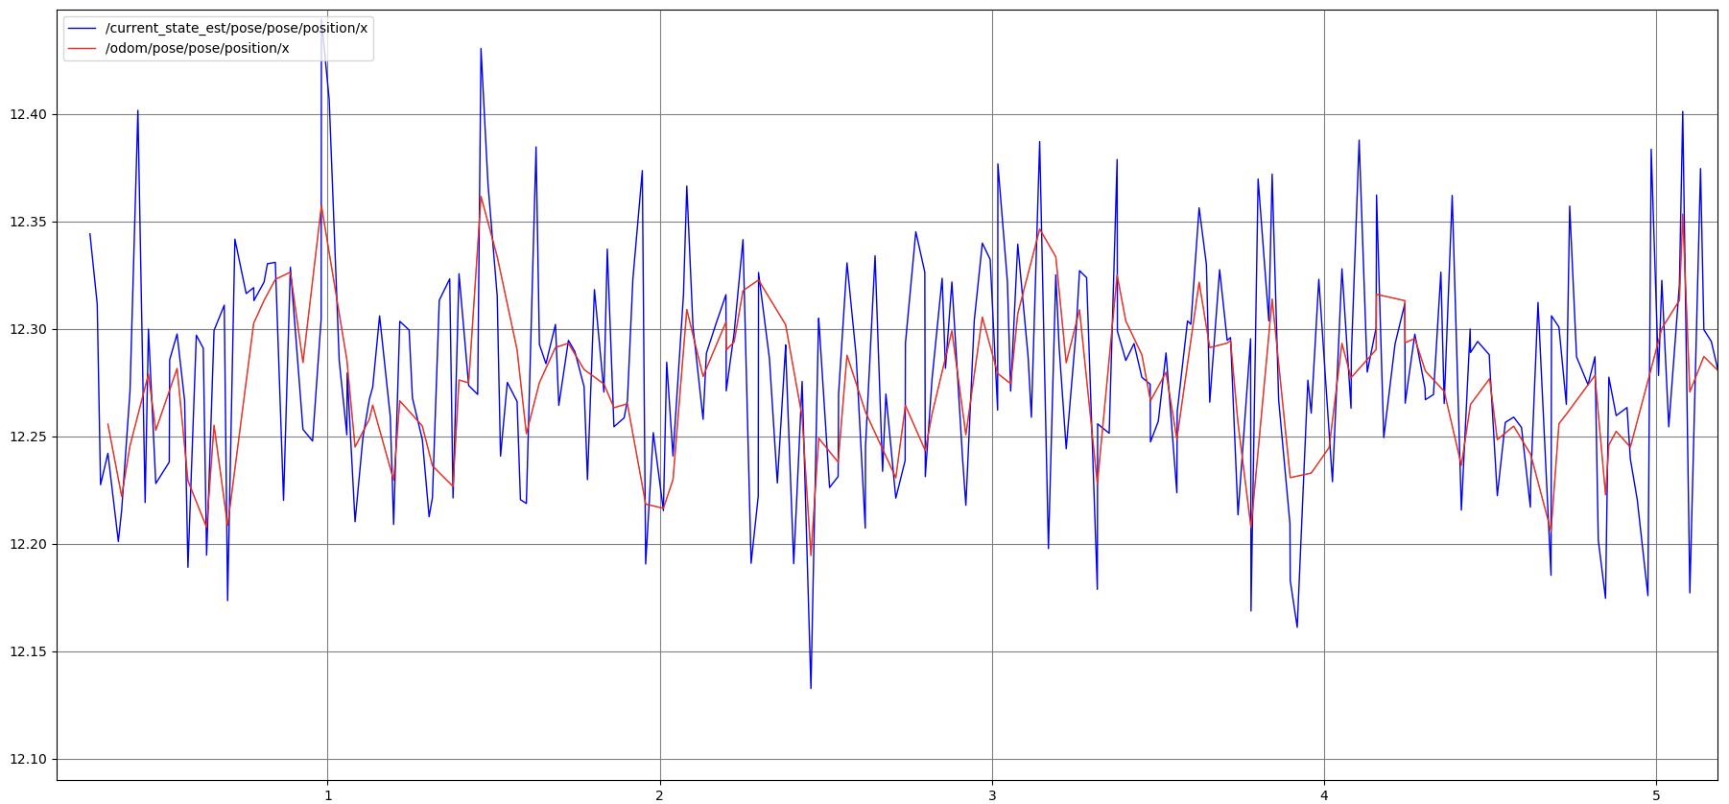
Extended Kalman filter
Used in Route 2
Leads to relative smoother planning and control with great noise
Notes:
EKF is used in route 2 to explore whether the noise has an impact on the performance. We found that with tiny noise, it is not necessary, but with a huge noise, it leads to relative smoother performance.

Slide 20
Insights
Lang global path leads to smooth and consistent local path
Consistent way points' orientation leads to smooth local path
Refresh frequency of global path composes partially unseen occupancy map
obersevation_persistance to compose the camera of point cloud
Simple but direct methods may leads to higher performance compared with complex methods on specific tasks
Trade-off between resources and complexities of methods is important
With a specific stop point some incorrect situations can be avoided.

